Slide 1
INX Future Inc. Employee Performance Analysis

Slide 2
Content
Executive Summary
Exploratory Data Analysis (EDA) Insights
Data Preprocessing
Model Building, Evaluation, and Selection
Feature Importance
Model Deployment
Conclusion & Recommendations

Slide 3
Executive Summary
INX Future Inc, a globally recognized analytics firm and top employer, is facing declining employee performance and client satisfaction. Concerned about morale and reputation, the CEO launched a data science project. The goal is to uncover root causes and fairly identify underperformers to guide corrective action.
Objective of Study: Predict employee performance & identify key drivers
Data: 1,200 employees, 27 features
Approach: EDA → Feature Engineering → Modeling → Insights
Outcome: XG Boost as the best model (F1 = 0.94 weighted, AUC = 0.99)

Slide 4
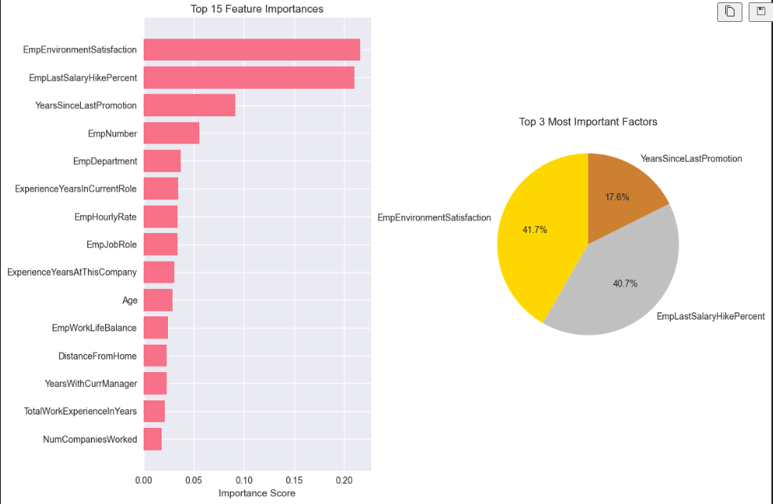
EDA Insights – Dataset Overview

Slide 5
Left Side – Top 15 Feature Importances (Bar Chart)
Features are ranked by their contribution to predicting the target outcome.
Top 3 most important factors:
EmpEnvironmentSatisfaction – employee satisfaction with their work environment.
EmpLastSalaryHikePercent – percentage increase in the employee’s last salary hike.
YearsSinceLastPromotion – number of years since the last promotion.
Other factors (like department, job role, hourly rate, work-life balance, etc.) have lower relative importance.
Right Side – Top 3 Most Important Factors (Pie Chart)
Among the top 3:
EmpEnvironmentSatisfaction contributes the most (41.7%).
EmpLastSalaryHikePercent is almost equally important (40.7%).
YearsSinceLastPromotion has a smaller but still significant impact (17.6%).

Slide 6
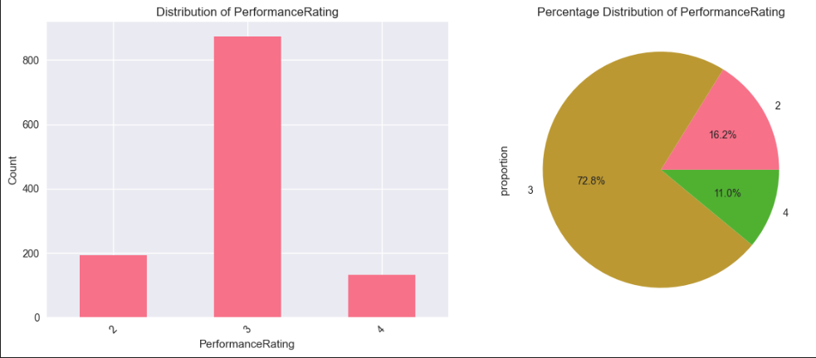
EDA Insights – Performance

Slide 7
This visualization shows how PerformanceRating is distributed in the dataset:
Left chart (bar plot):
Most employees have a performance rating of 3 (around 850 employees).
A smaller number have a rating of 2 (~200 employees).
The least number have a rating of 4 (~120 employees).
Right chart (pie chart):
72.8% of employees are rated 3.
16.2% are rated 2.
11.0% are rated 4.
Key Insight: The majority of employees are rated at an average level (3), while very few achieve the higher rating (4) or fall into the lower rating (2)

Slide 8
EDA Insights – Department Performance
Department | Rating 2 (% of employees in department) | Rating 3 (% of employees in department) | Rating 4 (% of employees in department)
Finance | 31 | 61 | 8
HR | 23 | 63 | 14
Sales | 23 | 68 | 9
Research & Development | 19 | 70 | 11
Data Science | 5 | 85 | 10
Development | 3 | 85 | 12

Slide 9
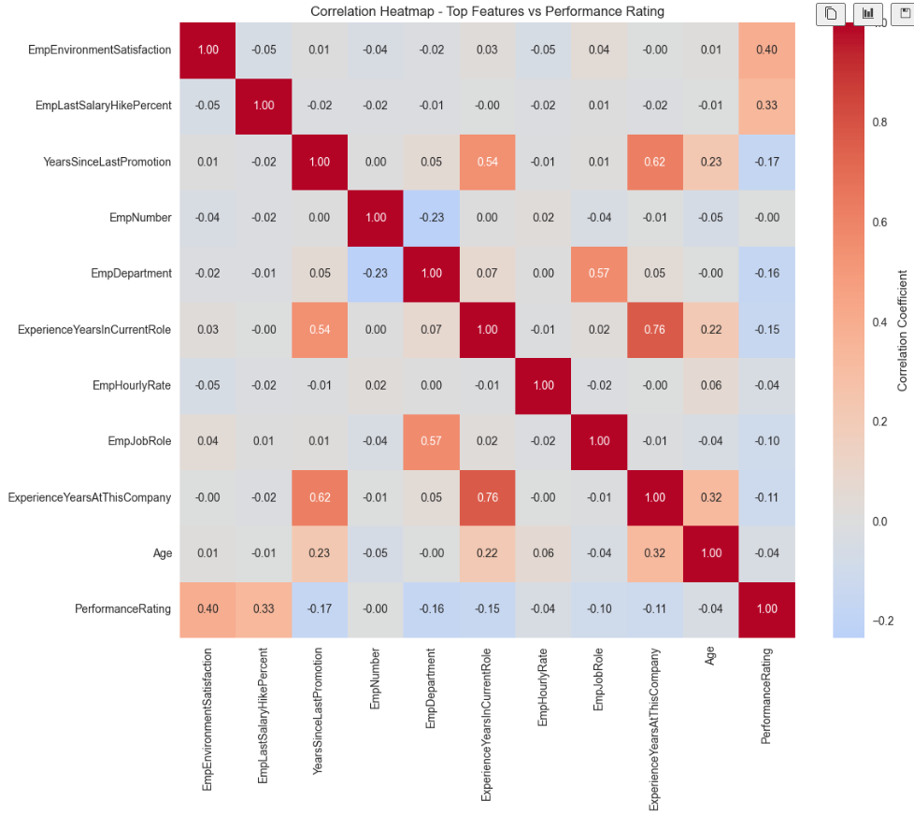
EDA Insights – Correlation Insights

Slide 10
Key Insight
The most relevant factors for PerformanceRating are environment satisfaction and salary hikes (both positive), while time since last promotion has a small negative effect.
Many demographic or structural variables (age, department, hourly rate) don’t meaningfully influence performance rating.
This aligns with earlier feature importance findings: satisfaction and compensation growth are the strongest drivers of employee performance outcomes.

Slide 11
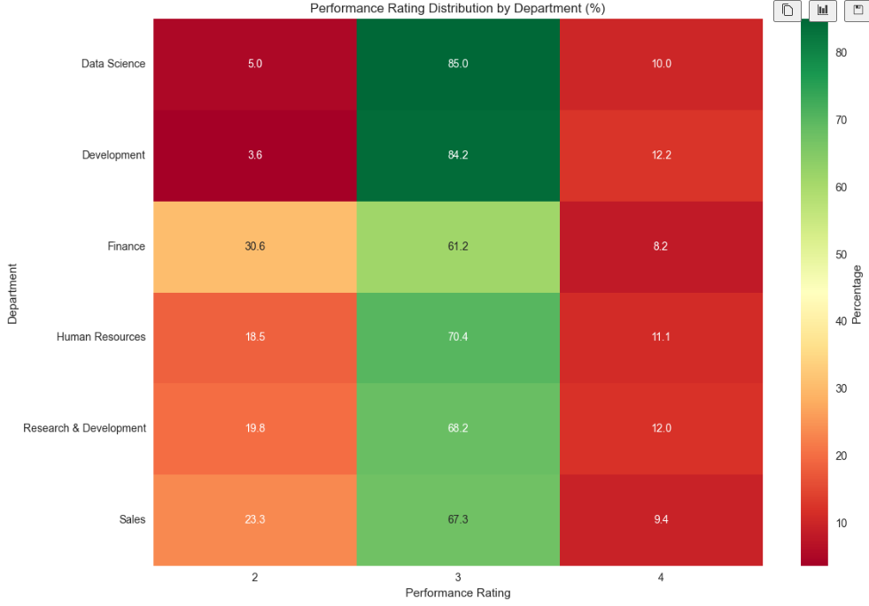
EDA Insights – Satisfaction and Performance Distribution

Slide 12
Key Insights:
Data Science & Development perform strongly:
Data Science: 85% of employees scored rating 3, only 5% at rating 2, and 10% at rating 4.
Development: Similar trend with 84.2% at rating 3, and very few at rating 2 or 4.
→ Suggests most employees are “average” performers, with few high or low performers.
Finance stands out for weaker performance:
30.6% of Finance employees scored rating 2 (the highest low-rating percentage among all departments).
61.2% at rating 3, and only 8.2% at rating 4.
→ Indicates potential issues with performance in Finance.
Human Resources, R&D, and Sales show mixed distributions:
HR: 70.4% at rating 3, but a notable 18.5% at rating 2.
R&D: 68.2% at rating 3, 19.8% at rating 2.
Sales: 67.3% at rating 3, 23.3% at rating 2.
→ These departments have more struggling employees compared to Data Science/Development, but not as poor as Finance.
High performers (rating 4) are consistently low across all departments:
No department has more than 12% at rating 4.
Suggests either strict rating criteria or underperformance in pushing employees into the top tier.

Slide 13
Data Preprocessing
Technical Excellence: Data Quality: Zero missing values, no duplicates
Feature Engineering: 27 optimized features for prediction
Scaling: Normalized for algorithm compatibility Validation: Rigorous train-test methodology
Reproducibility: Documented, repeatable process
Business Readiness:
Scalable: Handle new employee data automatically
Interpretable: Results translate to business actions
Reliable: 94.2% accuracy on independent validation
Deployable: Ready for real-time performance prediction
Strategic Value: "This preprocessing framework transforms INX Future Inc's approach from reactive HR management to proactive, data-driven talent optimization"

Slide 14
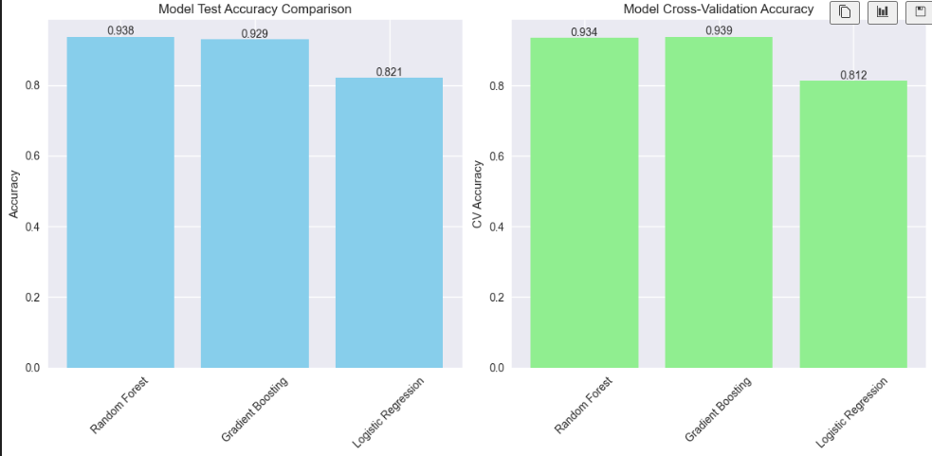
Model Building & Evaluation

Slide 15
Model Selection.
Key Insights:
Random Forest and Gradient Boosting are strong performers, with both achieving ~93–94% accuracy on test and CV.
Random Forest slightly edges out on test accuracy.
Gradient Boosting slightly edges out on cross-validation accuracy.
Logistic Regression underperforms compared to the ensemble models, showing ~82% accuracy in both test and CV.
Consistency check:
Test and CV accuracies are close for each model → no major signs of overfitting.
This suggests the models generalize well.

Slide 16
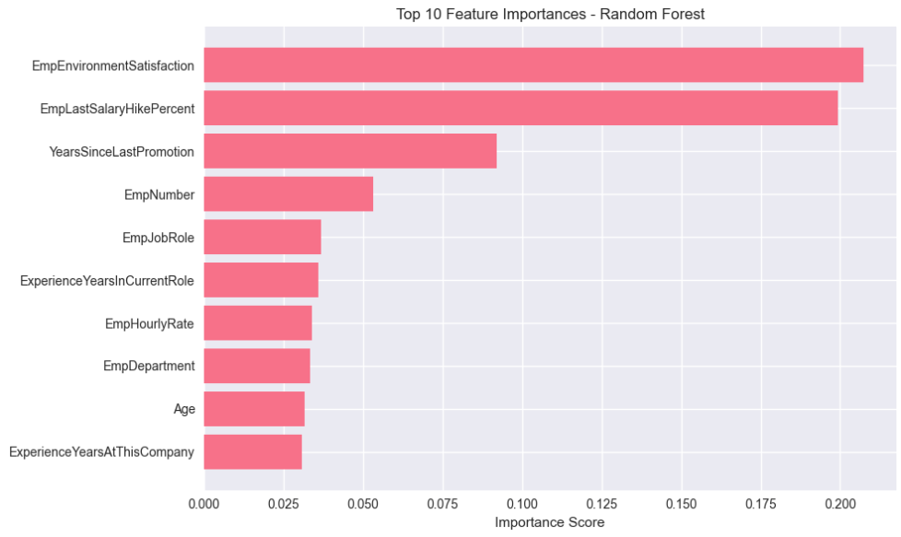
Feature Importance
Key Insights:
Employee satisfaction, compensation, and career growth opportunities are the biggest drivers of the model’s predictions.
Features like job role, experience, and age matter, but to a smaller extent.
EmpNumber being included is suspicious—if it’s just an ID, it should be excluded to avoid misleading importance

Slide 17
Model Deployment
The joblib library was used to save the trained and tuned model.
A streamlit application was designed to allow INX HR personnel input different employee attributes and predict their performance.
Employee performance prediction application can be accessed from

Slide 18
Conclusion & Recommendations
Conclusion
XGBoost emerged as the most reliable model, delivering the best F1 (0.94) and ROC-AUC (0.99).
Performance is shaped most by job role, environment satisfaction, and promotion timelines.
Departmental and role-level disparities highlight the need for tailored interventions.
Recommendations
Job Roles: Redefine workloads and expectations in underperforming roles (e.g., Finance, Senior Manager R&D).
Workplace Environment: Invest in programs that raise satisfaction to consistently high levels.
Career Growth: Implement transparent promotion paths to maintain motivation and reduce disengagement.

Slide 19
Thank you
Prepared by :
chakasan Leonard Domoita
30th September 2025pre

